Slide 1

German Loan Approvals

Slide 2

Dataset
German Credit data was sourced from the Penn State Dept. of Statistics under Creative Commons license CC BY-NC 4.0.
A single-column .csv with features and values separated by semicolons.

Slide 3
Cleaning
Split the data into 21 columns
Change datatype for numeric data

Slide 4
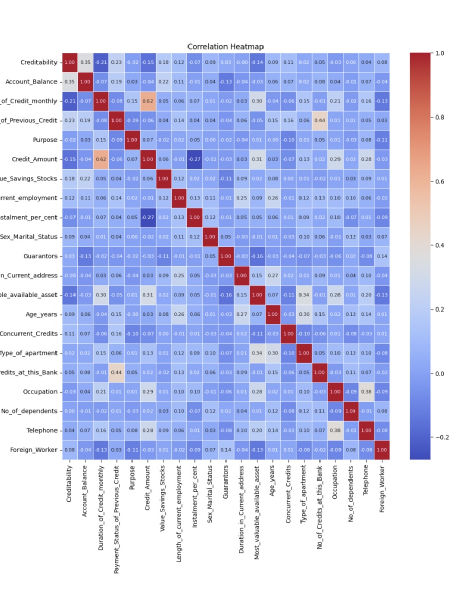
Exploring Correlations
Removed features with near zero correlation values (> ±0.05)
'No_of_dependents', 'Telephone', 'Occupation', 'Type_of_apartment', 'Duration_in_Current_address', 'Guarantors', 'Purpose'

Slide 5
Encoding & Splitting
Ordinal data received the label encoding treatment
Nominal data was target encoded
80-20 train-test
'Account_Balance'
'Foreign_Worker'

Slide 6
Modeling
Logistic Regression
Random Forest Classification
Gradient Boosting

Slide 7
Logistic Regression
Gradient Boosting
Precision for class 1: 0.78
Confusion Matrix: FP = 36, TP = 124
Random Forest
Precision for class 1: 0.80
Confusion Matrix: FP = 31, TP = 122
Precision for class 1: 0.79
Confusion Matrix: FP = 33, TP = 126

Slide 8
Conclusion
In the context of loan approval, it is most important for a model to minimize the amount of false positive approvals. Gradient Boosting proved to be the best fit for this task, boasting the highest precision for class 1 and the least false positives.
Recommending: Gradient Boosting Classification Model

